Slide 1

Unit-1 Introduction to Operating System
Operating System (OS)
GTU # 3140702
Prof. Firoz A Sherasiya
Computer Engineering Department
firoz.sherasiya@darshan.ac.in
9879879861

Slide 2

Looping
Outline
Computer system overview
Computer system architecture
What is Operating System (OS)
Roles of Operating System (OS)
Objectives / Goals of Operating System (OS)
Generations of Operating Systems (OS)
Operating Systems (OS) services
Types of Operating Systems (OS)
System calls
Operating Systems (OS) structure
Multiprogramming v/s Multiprocessing v/s Multitasking
Time Sharing Operating System
Parallel Processing Operating System
Distributed Operating System

Slide 3
Computer system overview
Section - 1

Slide 4
Basic elements of computer
Processor
I/O Modules
Memory
System Bus

Slide 5
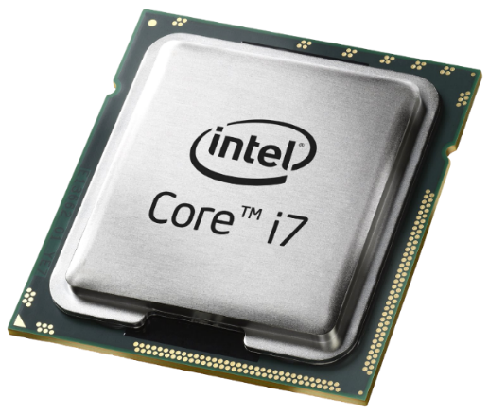
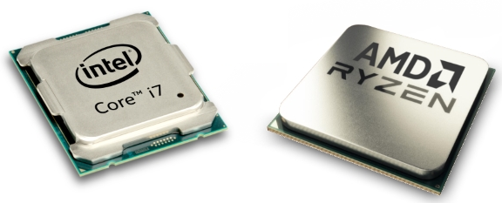
Processor
Referred to as the Central Processing Unit (CPU)
Arithmetic & Logic Unit
Control Unit
Performs the data processing functions
Controls the operation of the computer
Exercise
Which two companies are famous for manufacturing computer processors?

Slide 6
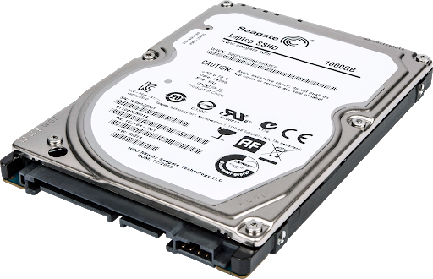
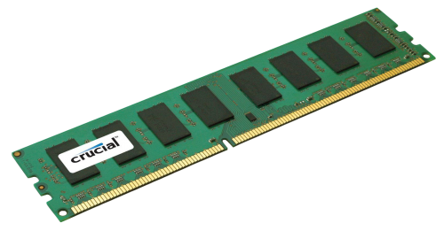
Memory
Memory is device that is used to store data/information
Primary Memory
Secondary Memory
Volatile
RAM & ROM
Non-Volatile
HDD, CD & DVD
Exercise
Give the difference between primary memory and secondary memory.

Slide 7
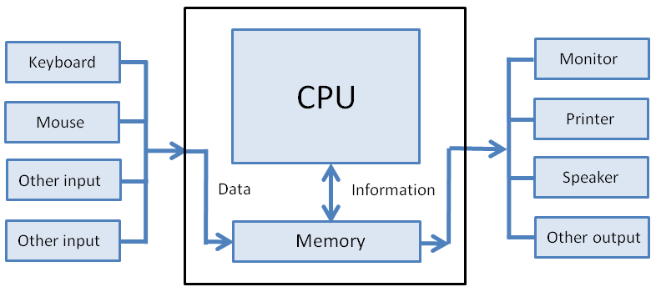
I/O Module (Input/Output Module)
Input/output module is a device that acts as the connective bridge between a computer system at one end and an I/O or peripheral device at the other, such as a printer, webcam or scanner.
An I/O module is a mediator between the processor/memory and an I/O devices.
It controls the data exchange between the external devices and main memory or external devices and CPU registers.

Slide 8
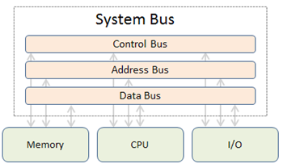
System Bus
Provides communication among processors, main memory, and I/O devices.
The system bus is a pathway composed of cables and connectors used to carry data between a computer microprocessor and the main memory.
Types of buses
Address bus - carries memory addresses from the processor to other components such as primary storage and input/output devices.
Data bus - carries the data between the processor and other components.
Control bus - carries control signals from the processor to other components.
Exercise
What are the 3 types of buses?

Slide 9
Computer system architecture
Section - 2

Slide 10
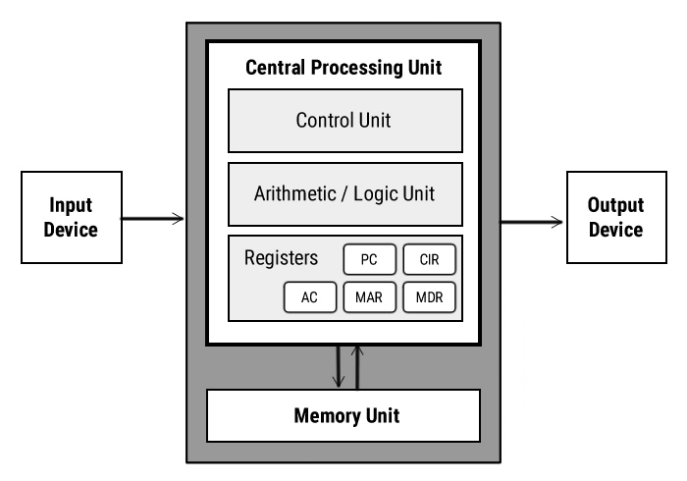
Computer system architecture

Slide 11
Input unit
It provides data and instructions to the computer system.
Commonly used input devices are keyboard, mouse, magnetic tape etc.
Input unit performs following tasks:
Accept the data and instructions from the outside environment.
Convert it into machine language.
Supply the converted data to computer system.

Slide 12
Output unit
It connects the internal system of a computer to the external environment.
It provides the results of any computation, or instructions to the outside world.
Some output devices are printers, monitor etc.

Slide 13
Storage unit
This unit holds the data and instructions.
It also stores the intermediate results before these are sent to the output devices.
It also stores the data for later use.
The storage unit of a computer system can be divided into two categories:
Primary Storage
Secondary Storage

Slide 14
Primary storage (memory) vs Secondary storage (memory)
Primary storage | Secondary storage
Examples: RAM, ROM, Cache memory, PROM, EPROM, Registers, etc. | Examples: Hard Disk, Floppy Disk, Magnetic Tapes, etc.
It is temporary and volatile. | It is permanent and Non-volatile.
Primary memory is directly accessible by Processor/CPU. | Secondary memory is not directly accessible by the CPU.
Primary memory devices are expensive. | Secondary memory devices are cheaper.
The memory devices used for primary memory are semiconductor memories. | The secondary memory devices are magnetic and optical memories.
Primary memory is also known as Main memory or Internal memory. | Secondary memory is also known as External memory or Auxiliary memory.

Slide 15
CPU (Central Processing Unit)
The Arithmetic Logical Unit and Control Unit are together known as CPU.
CPU is the brain of computer system.
It performs following tasks:
performs all operations.
takes all decisions.
controls all the units of computer.

Slide 16
ALU (Arithmetic Logical Unit)
All the calculations are performed in ALU of the computer system.
The ALU can perform basic operations such as addition, subtraction, division, multiplication etc.
Whenever calculations are required, the control unit transfers the data from storage unit to ALU.
When the operations are done, the result is transferred back to the storage unit.

Slide 17
CU (Control Unit)
It controls all other units of the computer.
It controls the flow of data and instructions to and from the storage unit to ALU.
Thus it is also known as central nervous system of the computer.

Slide 18
What is Operating System (OS)
Section - 3

Slide 19
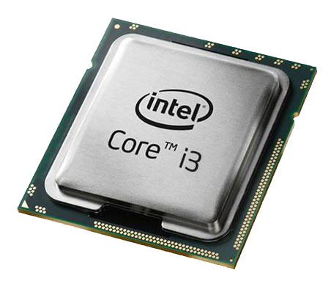
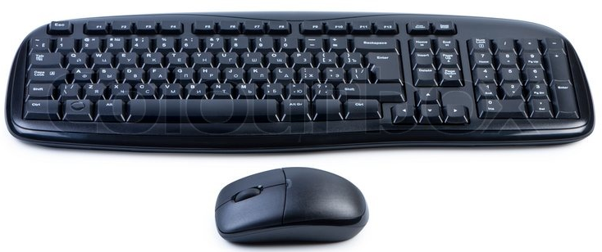
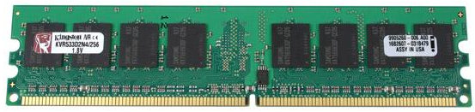
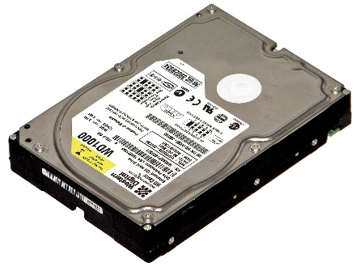

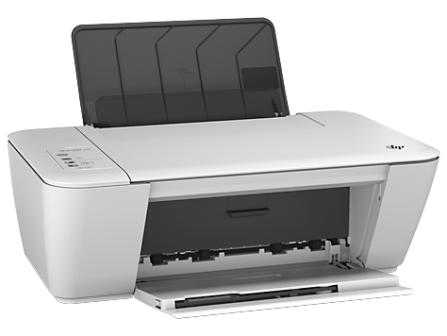
What is Operating System (OS)?
A Computer System consists of various hardware's such as
Processor
RAM
Keyboard & Mouse
Hard Disk
Monitor
Printer
Who manages (controls) these hardwares???
Operating System

Slide 20
Definition of Operating System (OS)
An Operating System (OS) is a collection of software that
manages hardware resources
provides various service to the users

Slide 21
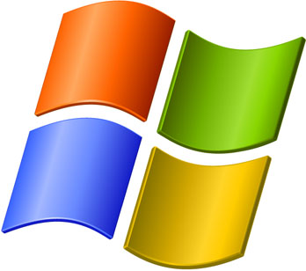
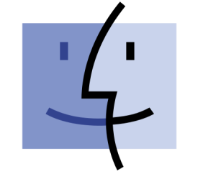




Examples of Operating System (OS)
Examples
of Operating System

Slide 22

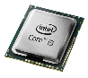
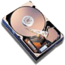

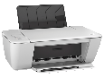
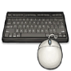
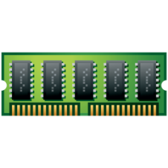
Where OS lies? (Interaction of OS & Hardware)
OS lies between hardware and user program.
It acts as an intermediary between the user and the hardware.
Modes of operation of computer
Kernel Mode
has complete access to all the hardware
can execute any instruction that a machine is capable of executing
has high privileged (rights)
User Mode
has limited access to limited hardware
can execute only subset (few) of the machine instructions
has less privileged (rights)
Web
browser
E-mail
reader
Music
player
User
Mode
User Program
Software
Operating System
Kernel
Mode
Hardware

Slide 23
Why and How switch occur?
Web
browser
E-mail
reader
Music
player
User is writing program in C.
Once finish writing will execute it.
User
Mode
user-mode program
performs trap instruction
User Program
Software
Operating System
Kernel
Mode
To execute this program
Load program into RAM
Program is executed by processor
Hardware

Slide 24
Roles of Operating System (OS)
Section - 4

Slide 25

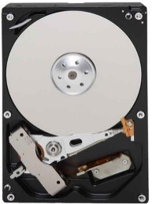
OS as Extended Machine
The architecture of a computer is difficult to program
Architecture (instruction set, memory organization, I/O, bus structure) of most of computer at the machine level language is primitive and awkward to program.
Example: If user want to read from floppy or hard disk:

Slide 26



OS as Extended Machine
Example: If user want to read from floppy or hard disk:
User has to write command and address to the disk controller and then initiate the I/O.
Disk Controller

Slide 27

OS as Extended Machine
The disk controller will find the requested data in the disk and fetch it from disk to disk controller buffer.
User has to check the status of disk controller operation where it has finished or not.

Slide 28

OS as Extended Machine
If success, the data from disk controller buffer should be moved to main memory (to the application buffer).

Slide 29
OS as Extended Machine
If all the users will have to do these messy details:
The program will be very difficult to write and quite long.
The program will be hardware dependent.
User don’t want to be involved in programming of storage devices.
Therefore, an OS provides a set of basic commands or instructions to perform various operations such as read, write, modify, save or close.
Dealing with these command is easier than directly dealing with hardware.
Operating system hides the complexity of hardware and present a beautiful interface to the users.

Slide 30

OS as Resource Manager
There are lots of resources in computer system
CPU (Processor)
Memory
I/O devices such as hard disk, mouse, keyboard, printer, scanner etc.
If a computer system is used by multiple applications (or users), then they will compete for these resources.

Slide 31
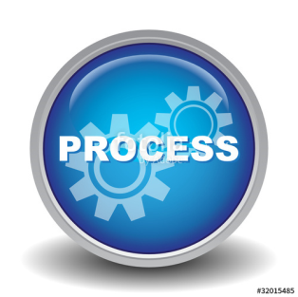
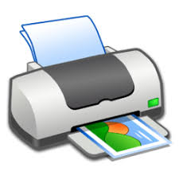

OS as Resource Manager
It is the job of OS to allocate these resources to the various applications so that:
The resources are allocated fairly (equally)
Wants to print 50 lines
P1
After printing 10 lines of P1
Wants to print 20 lines
P2
After printing 20 lines of P1
Wants to print 15 lines
P3
Wants to print 15 lines
P4

Slide 32
OS as Resource Manager
It is the job of OS to allocate these resources to the various applications so that:
The resources are protected from cross-access.
Wants to print 50 lines
P1
After printing 10 lines of P1
Wants to print 20 lines
P2
After printing 20 lines of P1
Wants to print 15 lines
P3
Wants to print 15 lines
P4

Slide 33
OS as Resource Manager
It is the job of OS to allocate these resources to the various applications so that:
Access to the resources is synchronized so that operations are correct and consistent
Example: If we write a program to calculate below in C language
7 + 9 – 6 * 4 / 2 = 4
P1
P2
P3
P4
20
3
4
1
2

Slide 34
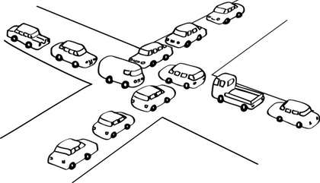
OS as Resource Manager
It is the job of OS to proper allocate these resources to the various applications so that:
Deadlock are detected, resolved and avoided.

Slide 35
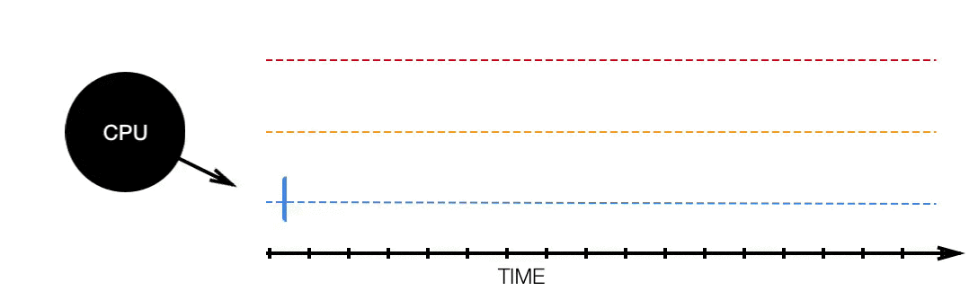
OS as Resource Manager
Resource manager – sharing resources in two different ways:
In time sharing/multiplexing (i.e CPU)

Slide 36
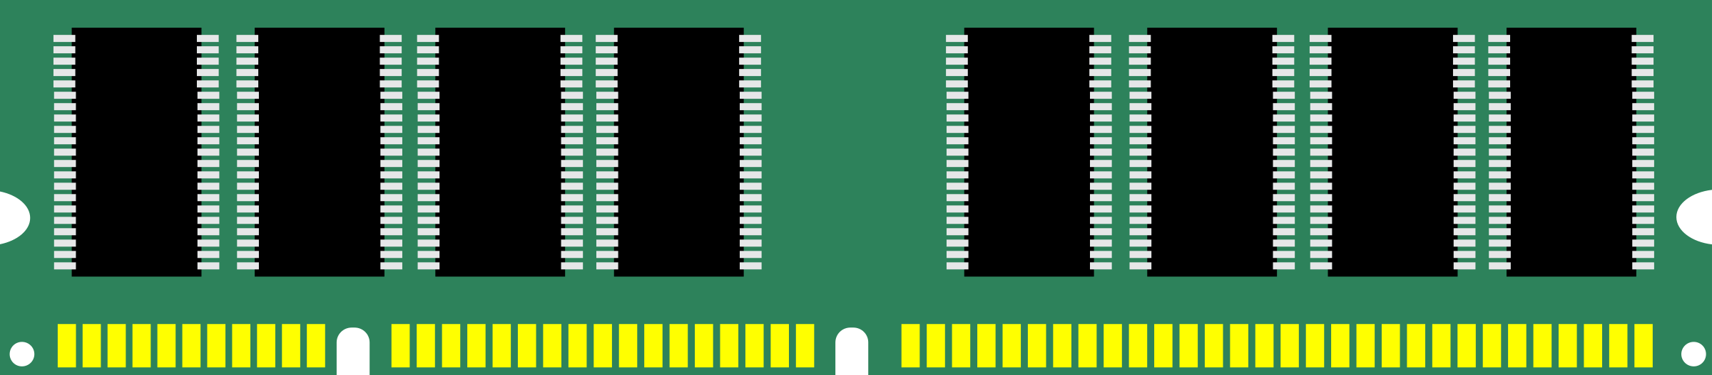
OS as Resource Manager
Resource manager – sharing resources in two different ways
In space sharing/multiplexing. (i.e Memory)
Process 1
Process
2
Process
3
Empty Space
Main Memory

Slide 37
Objectives / Goals of Operating System (OS)
Section - 5

Slide 38
Objectives / Goals of Operating System (OS)
Make the computer system convenient to use in an efficient manner.
Hide the details of the hardware resources from the users.
Provide users a convenient interface to use the computer system.
Act as an intermediary between the hardware and its users, making it easier for the users to access and use other resources.
Manage the resources of a computer system.
Keep track of who is using which resource, granting resource requests, and mediating conflicting requests from different programs and users.
Provide efficient and fair sharing of resources among users and programs.

Slide 39
Generations of Operating Systems (OS)
Section - 6

Slide 40
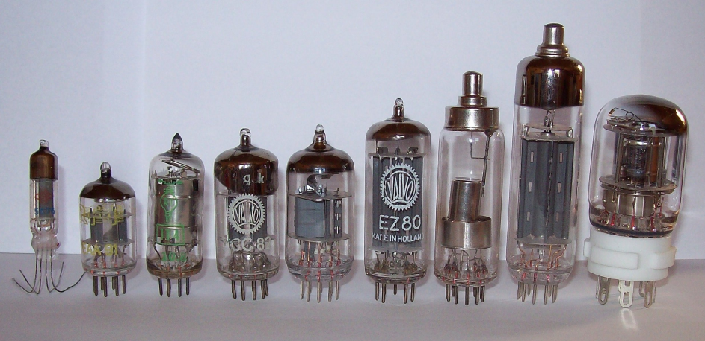
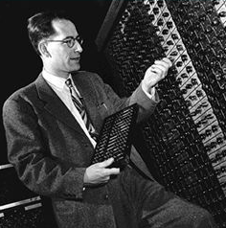
Generations / History of OS (First generation)
First generation (1945-1955)
Vacuum tubes and plug-boards are used in these systems.
Vacuum tubes
Plug board

Slide 41
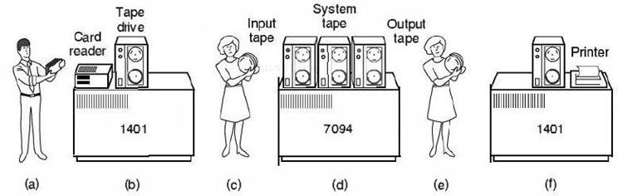
Generations / History of OS (Second generation)
Second generation (1955-1965)
Transistors are used in these systems
The machine that are produced are called mainframes.
Batch systems was used for processing.
Programmers bring cards to 1401
1401 reads batch of jobs onto tape
Operator carries input tape to 7094
7094 does computing
Operator carries output tape to 1401
1401 prints output

Slide 42
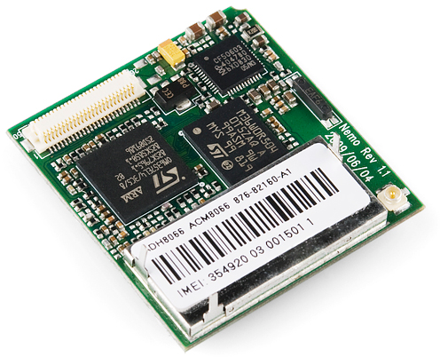
Generations / History of OS (Third generation)
Third generation (1965-1980)
Integrated circuits (IC's) are used in place of transistors in these computers.
It provides multiprogramming (the ability to have several programs in memory at once, each in its own memory partition).

Slide 43
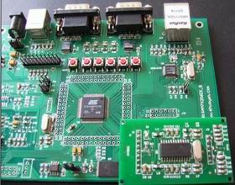
Generations / History of OS (Forth generation)
Fourth generation (1980-present)
Personal Computers (PC)
LSI (Large Scale Integration) circuits, chips containing thousands of transistors are used in these systems.

Slide 44
Operating Systems (OS) services
Section - 7

Slide 45

Services / Functions / Tasks of Operating System (OS)
Definition of Operating System
An Operating System (OS) is a collection of software that
manages hardware resources
provides various service to the users

Slide 46

Services / Functions / Tasks of Operating System (OS)
Program development
It provides editors and debuggers to assist (help) the programmer in creating programs.
Exercise
Give the name of any five code editor for windows?

Slide 47
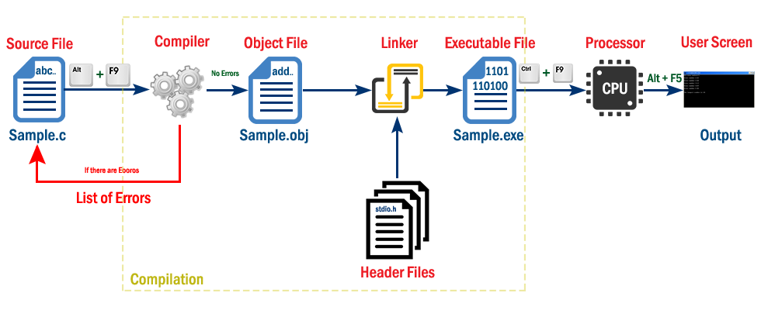
Services / Functions / Tasks of Operating System (OS)
Program execution
Following tasks need to be perform to execute a program:
Instructions and data must be loaded into main memory.
I/O devices and files must be initialized.
The OS handles all these duties for the user.

Slide 48

Services / Functions / Tasks of Operating System (OS)
Access to I/O devices (Resource allocation)
A running program may require I/O, which may involve file or an I/O device.
For efficiency and protection, users cannot control I/O devices directly.
Therefore, the OS controls these I/O devices and provides to program as per requirement.

Slide 49
Services / Functions / Tasks of Operating System (OS)
Memory management
OS manages memory hierarchy.
OS keeps the track of which part of memory area in use and free memory.
It allocates memory to program when they need it.
It de-allocate the memory when the program finish execution.
P1
P2

Slide 50
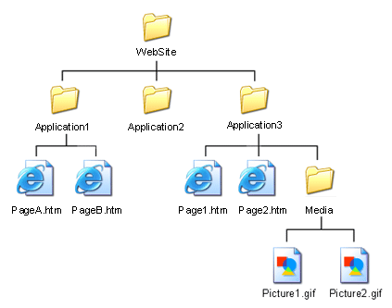
Services / Functions / Tasks of Operating System (OS)
Controlled access to file
In case of file access, OS provides a directory hierarchy for easy access and management of file.
OS provides various file handling commands using which user can easily read, write and modify file.

Slide 51
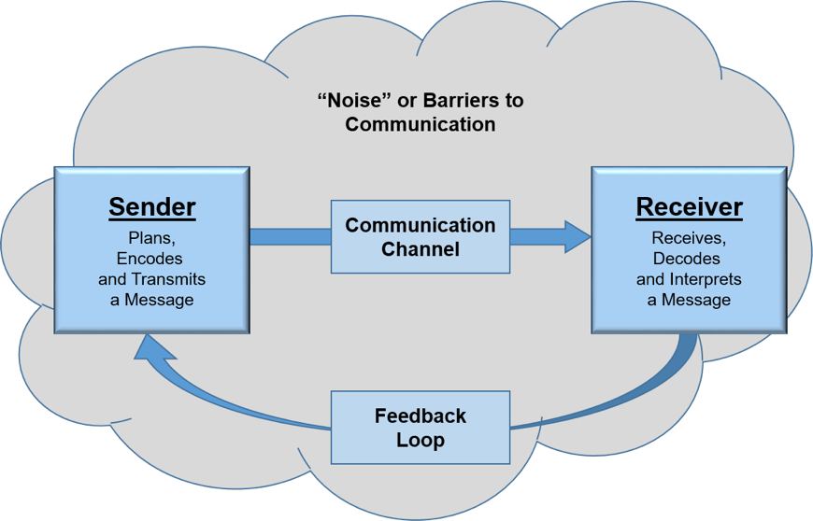
Services / Functions / Tasks of Operating System (OS)
Communication
In multitasking environment, the processes need to communicate with each other and to exchange their information.
Operating system performs the communication among various types of processes in the form of shared memory.

Slide 52
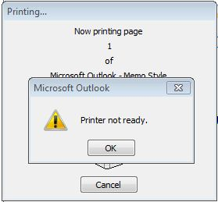
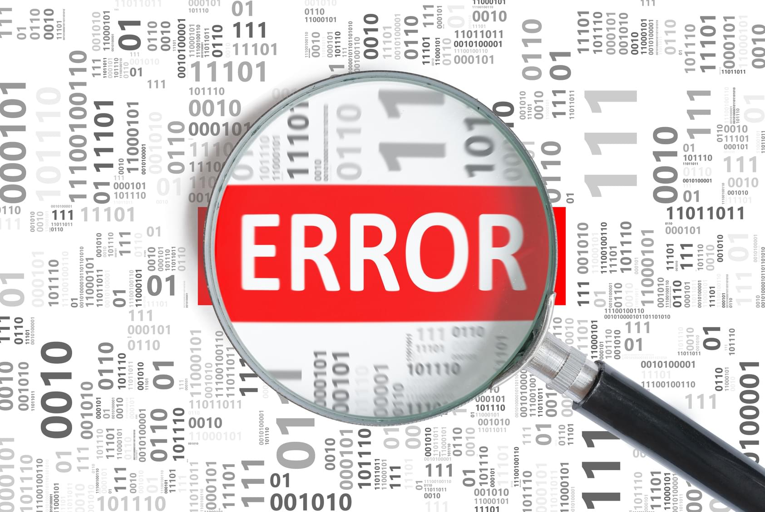
Services / Functions / Tasks of Operating System (OS)
Error detection and response
An error may occur in CPU, in I/O devices or in the memory hardware.
Following are the major activities of an operating system with respect to error handling −
The OS constantly checks for possible errors.
The OS takes an appropriate action to ensure correct and consistent computing.

Slide 53
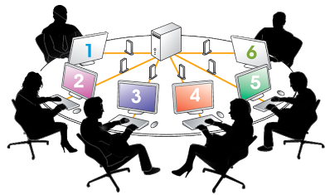
Services / Functions / Tasks of Operating System (OS)
Accounting
Keeping a track of which users are using how much and what kinds of computer resources can be used for accounting or simply for accumulating usage statistics.
Usage statistics is used to reconfigure the system to improve computing services.

Slide 54
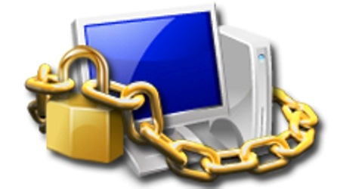
Services / Functions / Tasks of Operating System (OS)
Protection & Security
Protection involves ensuring that all accesses to system resources is controlled.
To make a system secure, the user needs to authenticate himself or herself to the system.

Slide 55
Types of Operating Systems (OS)
Section - 8

Slide 56
Types of Operating Systems (OS)
Mainframe operating systems
OS found in room sized computers which are still found in major corporate data centers.
They offer three kinds of services:
Batch OS
Transaction processing
Timesharing
Examples: OS/390, OS/360.

Slide 57
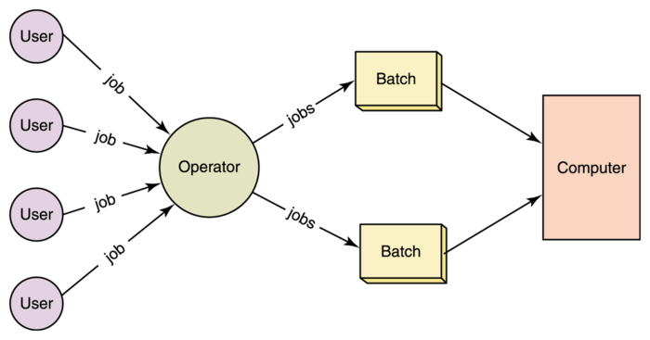
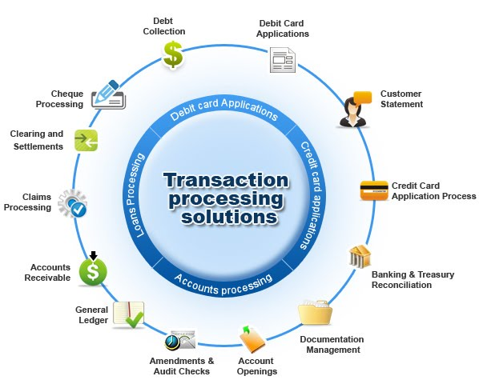
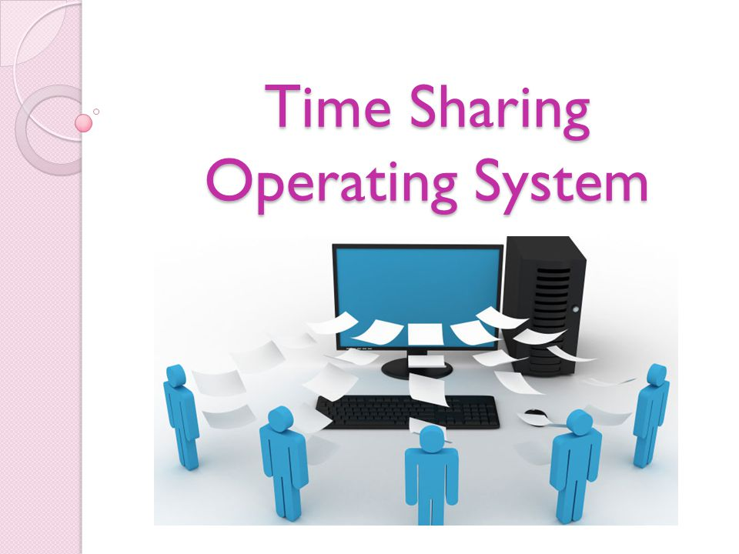
Mainframe Operating Systems services
Batch OS – processes routine jobs without any interactive user presents i.e. claim processing in insurance
Transaction processing – handles large numbers of small processes i.e. cheque processing at banks
Timesharing – allows multiple remote users to run their jobs at once i.e. querying a database, airline booking system

Slide 58
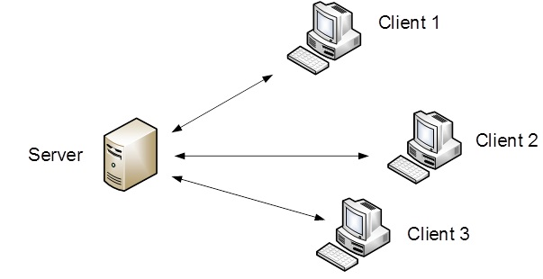
Types of Operating Systems (OS)
Server operating systems
This OS runs on servers which are very large PC, workstations or even mainframes.
They serve multiple users at once over a network and allow the users to share hardware & software resources.
It provides print services, file service or web service.
It handles the incoming requests from clients.
Examples: Solaris, FreeBSD, and Linux and Windows Server 200x.

Slide 59
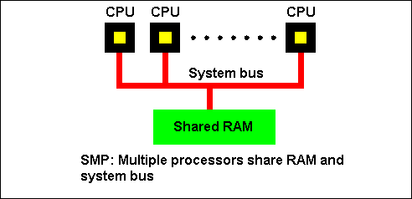
Types of Operating Systems (OS)
Multiprocessor operating systems
A computer system consist two or more CPUs is called multiprocessor.
It is also called parallel computers, multicomputer or multiprocessor.
They need special OS or some variations on server OS with special features for communication, connectivity and consistency.
Examples: Windows and Linux.

Slide 60
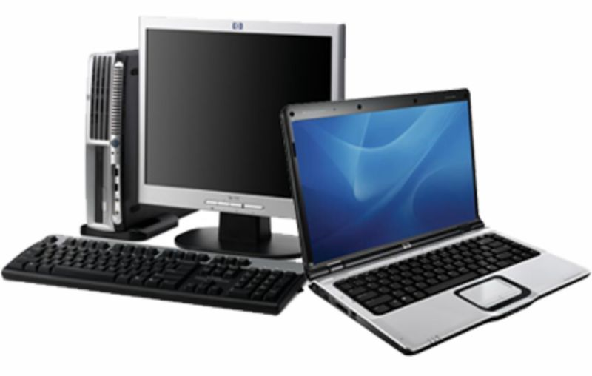
Types of Operating Systems (OS)
Personal computer operating systems
The operating systems installed on our personal computer and laptops are personal OS.
Job of this OS is to provide good support to single user.
This OS is widely used for word processing, spreadsheet and internet access.
Examples: Linux, Windows vista and Macintosh.

Slide 61
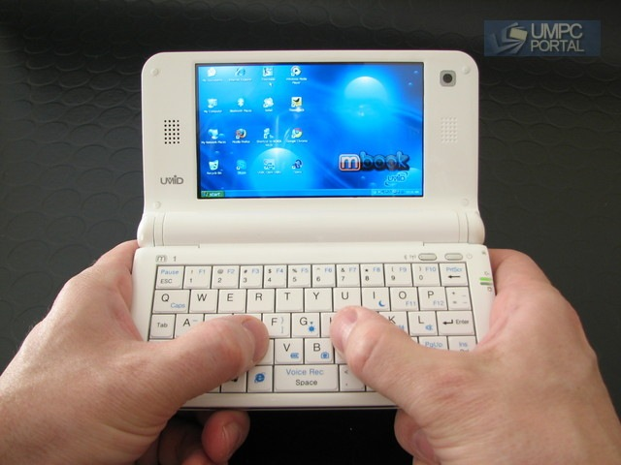
Types of Operating Systems (OS)
Handhelds computer operating systems
A handheld computer or PDA (Personal Digital Assistant) is small computer that fit in a Pocket and perform small number of functions such as electronic address book, memo pad.
The OS runs on these devices are handheld OS.
These OS also provides ability to handle telephony, digital photography and other functions.
Examples: Symbian OS, Palm OS.

Slide 62
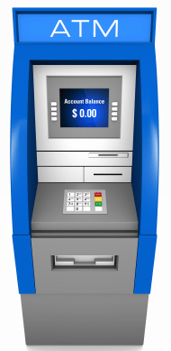
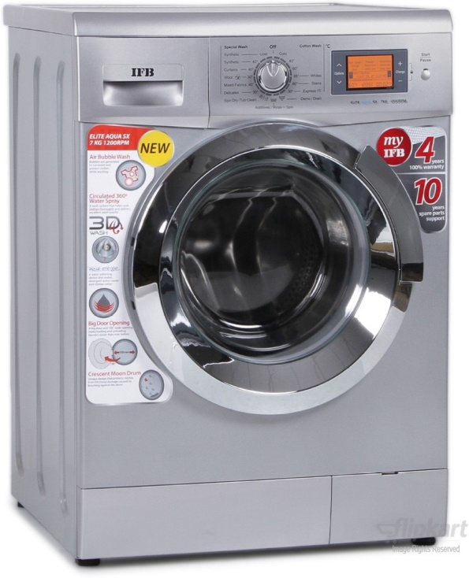
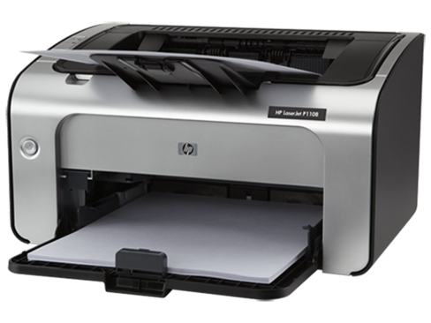
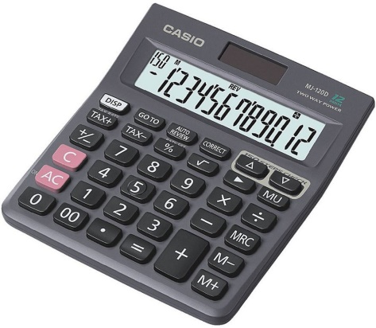
Types of Operating Systems (OS)
Embedded operating systems
This OS is installed in ATMs, printers, calculators and washing machine.
It runs on the computer that control devices.
It neither allow to download new software nor accept user installed software. So there is no need for protection.
Examples: QNX, VxWorks.

Slide 63
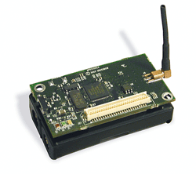
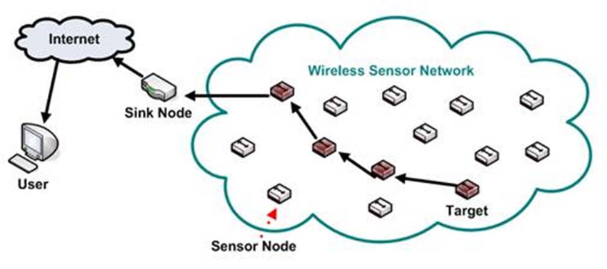
Types of Operating Systems (OS)
Sensor node operating systems
Network of tiny sensor nodes are being developed for numerous purpose.
Each nodes are tiny computers with a CPU, RAM, ROM and one or more environmental sensors.
The OS installed in these nodes are sensor node OS.
They communicate with each other and with base station using wireless communication.
These sensor network are used to protect area of building, detect fires in forest, measure temperature.
Examples: TinyOS.

Slide 64
Types of Operating Systems (OS)
Real time operating systems
These systems having time as a key parameter.
Real time OS has well defined fixed time constraints.
Processing must be done within defined time constraints otherwise system fails.
Two types of real time OS:
Hard real time – missing an occasional deadline can cause any permanent damage. Many of these are found in industrial process control, car engine control system.
Soft real time – missing an occasional deadline does not cause any permanent damage. Used in digital audio, multimedia system.
Examples: e-Cos.

Slide 65

Types of Operating Systems (OS)
Smart card operating systems
Smallest OS run on smart cards which are credit card sized devices containing CPU chip.
These OS are installed on electronic payments cards such as debit card, credit card etc.
They have limited processing power.
Some smart cards are Java oriented. ROM on smart card holds an interpreter for the JVM – small program.

Slide 66
System calls
Section - 9

Slide 67
What is System calls?
A system call is a way for programs to interact with the operating system.
A system call is a mechanism that provides the interface between a process and the operating system.
A computer program makes a system call when it makes a request to the operating system's kernel.
It is a programmatic method in which a computer program requests a service from the kernel of the OS.
System call provides the services of the operating system to the user programs via Application Program Interface(API).
System calls are the only entry points for the kernel system.

Slide 68
Types of system calls
Process Control: This system calls perform the task of process creation, process termination, etc.
Functions:
End and abort
Load and execute
Create process and terminate process
Wait and signed event
Allocate and free memory
File Management: File management system calls handle file manipulation jobs like creating a file, reading, and writing, etc.
Functions:
Create a file
Delete file
Open and close file
Read, write and reposition
Get and set file attributes

Slide 69
Types of system calls
Device Management: Device management does the job of device manipulation like reading from device buffers, writing into device buffers, etc.
Functions
Request and release device
Logically attach/ detach devices
Get and Set device attributes
Information Maintenance: It handles information and its transfer between the OS and user program.
Functions:
Get or set time and date
Get process and device attributes

Slide 70
Types of system calls
Communication: These types of system calls are specially used for interprocess communications (IPC).
Functions:
Create, delete communications connections
Send, receive message
Help OS to transfer status information
Attach or detach remote devices

Slide 71
Example of system calls (Read system call)
Example: In Unix Read system call is
count = read(fd, buffer, nbytes)
fd is a file descriptor.
When a file is opened, permissions are checked.
If access is allowed, a number (fd) is returned.
Then file can be read/written.
nbytes is number of bytes to read
buffer is where read deposits (stores) the data
Return to caller
Library
procedure
read
Trap to the kernel
5
Put code for read in register
6
10
User
space
Call to library proc
4
11
Increment SP
Call read
User
program
calling read
3
Push fd
Push parameter onto stack
2
Push &buffer
9
1
Push nbytes
Kernel
space
7
8
Dispatch
Sys call
handler

Slide 72
Steps involved in making a system call (Read system call)
Steps involved in making a system call
In steps 1-3, the calling program pushes the parameters onto the stack. The first and third parameters are called by value, but the second one is called by its address as denoted by the & symbol.
In step 4, the actual call to the library procedure is made. This instruction is the normal procedure call instruction used to call all procedures.
In step 5, the library procedure places the system call number in a place where the operating system expects it, such as a register.
In step 6, the library procedure executes a TRAP instruction to switch from user mode to kernel mode and start execution at a fixed address within the kernel.
In step 7, the kernel examines the system call number and then dispatches it to the correct system call handler. This correct number is given in the table of system call handlers by pointers referenced at the system call number.
In step 8, the system call handler runs.
In step 9, the operation is completed, and the user is given back control once the TRAP instruction is set.
In step 10, this procedure returns to the user program, like how all normal library procedures do.
In step 11, the operating system has to clear the stack, so it increments it enough so that it is empty.

Slide 73

System calls

Slide 74

System calls

Slide 75
Operating Systems (OS) structure
Section - 10

Slide 76
Operating Systems (OS) structure
Monolithic systems
Layered systems
Microkernel
Client-server model
Virtual machines
VM/370
Virtual machines rediscovered
The java virtual machine
Exokernels

Slide 77
Monolithic systems
The entire OS runs as a single program in kernel mode.
OS is written as a collection of procedures, linked together into a single large executable binary program.
Each procedure has well defined interface in terms of parameter and results, and each one is free to call any other one.
A main program that invoke the requested service procedure.
A set of service procedures that carry out the system calls.
A set of utility procedures that help the service procedure.
Main
Procedure
Service
Procedures
Utility
Procedure

Slide 78
Layered systems
In this system, the OS is organized as a hierarchy of layers.
The first system constructed in this way was THE system.
Layer | Function | Description
5 | Operator | Operator was located.
4 | User programs | User programs were found.
3 | Input / Output management | Takes care of managing the I/O devices. Buffering the information.
2 | Operator-process communication | Handles communication between each process and the operator console (i.e. user).
1 | Memory and drum management | Did the memory management. Allocated space for process in main memory and on a 512K word drum used for holding parts of processes for which there was no room in memory.
0 | Processor allocation and multi-programming | Provided the basic multiprogramming of the CPU. Dealt with allocation of the processor, switching between processes when interrupts occurred or timers expired.

Slide 79

Microkernel
In layered approach, the designer have choice where to draw the kernel and user mode boundary.
It is better to put as little as possible in kernel mode because bugs in the kernel can bring down the system instantly.
The microkernel design provides high reliability by splitting OS up into small well defined modules, only one module run in kernel and rest of all run in user mode.
As each device driver runs as a user process, a bug in audio driver will cause the sound to be stop, but not crash the computer.
Examples: Integrity, K42, QNX, Symbian and MINIX 3.
Kernel contains only
Sys (Kernel call handler)
Clock (because scheduler interact with it)

Slide 80

Client-Server model
Processes are divided into two categories
Servers: provide services
Clients: uses services
Client and server run on different computers, connected by LAN or WAN and communicate via message passing.
To obtain a service, a client construct a message saying what it wants and send it to server.
The server then does the work and send back the answer.

Slide 81
Virtual machines
A virtual machine (VM) is a virtual environment that functions as a virtual computer system with its own CPU, memory, network interface, and storage, created on a physical hardware system.
The initial releases of OS/360 were strictly batch systems.
But many users wanted to be able to work interactively at a terminal, so OS designers decided to write timesharing systems for it.
Types of Virtual machines are:
VM/370
Virtual Machines Rediscovered
The Java Virtual Machine

Slide 82

VM/370
Virtual machine monitor run on the bare hardware and does the multiprogramming.
Each virtual machine is identical to the true hardware; each one can run any OS (may be different) that will run directly on the bare hardware.
On VM/370, some run OS/360 while the others run single user interactive system called CMS (Conversational Monitor System) for interactive time sharing users.

Slide 83
VM/370
When CMS program executed a system call, a call was trapped to the operating system in its own virtual machine, not on VM/370.
CMS then issued the normal hardware I/O instruction for reading its virtual disk or whatever was needed to carry out the call.
These I/O instructions were trapped by VM/370 which then performs them.

Slide 84

Virtual Machines Rediscovered
Companies can run their mail servers, web servers, FTP servers and other servers on the same machine without having a crash of one server bring down the rest.
Web hosting company offers virtual machines for rent, where a single physical machine can run many virtual machines; each one appears to be a complete machine.
Customers who rent a virtual machine can run any OS or software.

Slide 85
Virtual Machines Rediscovered
Another use of virtualization is for end users who want to be able to run two or more operating systems at the same time, say Windows and Linux.
Type 1 hypervisors runs on the bare hardware.
Type 2 hypervisors run as application programs on top of Windows, Linux, or some other operating system, known as the host operating system.

Slide 86

Java Virtual Machine
When Sun Microsystems invented the Java programming language, it also invented a virtual machine called the JVM (Java Virtual Machine).
The Java compiler produces code for JVM, which then typically is executed by a software JVM interpreter.
The advantage is that the JVM code can be shipped over the internet to any computer that has a JVM interpreter and run there.

Slide 87
Exokernels
Rather than cloning (copying) the actual machine, another strategy is partitioning it (giving each user a subset of the resource).
For example one virtual machine might get disk blocks 0 to 1023, the next one might get block 1024 to 2047, and so on.
Program running at the bottom layer (kernel mode) is called the exokernel.
Its job is to allocate resources to virtual machines and then continuously check to make sure no machine is trying to use somebody else’s resources.
The advantage of the exokernel scheme is that it saves a layer of mapping.

Slide 88
Multiprogramming v/s Multiprocessing v/s Multitasking
Section - 11

Slide 89





Multiprogramming v/s Multiprocessing v/s Multitasking
Multiprogramming
Multiprocessing
Multitasking

Slide 90
Multiprogramming v/s Multiprocessing v/s Multitasking
Multiprogramming | Multiprocessing | Multitasking
The concurrent residency of more than one program in the main memory is called as multiprogramming. | The availability of more than one processor per system, which can execute several set of instructions in parallel is called as multiprocessing | The execution of more than one task simultaneously is called as multitasking.
Number of processor: one | Number of processor: more than one | Number of processor: one
One process is executed at a time. | More than one process can be executed at a time. | One by one job is being executed at a time.
Multitasking is a logical extension of multi programming. The major way in which multitasking differs from multi programming is that multi programming works solely on the concept of context switching whereas multitasking is based on time sharing alongside the concept of context switching.

Slide 91
Time Sharing Operating System
Section - 12

Slide 92


Time Sharing Operating System
A time sharing operating system allows many users to share the computer resources simultaneously.
In other words, time sharing refers to the allocation of computer resources in time slots to several programs simultaneously.
For example a mainframe computer that has many users logged on to it.
Each user uses the resources of the mainframe i.e. memory, CPU etc.

Slide 93
Parallel Processing Operating System
Section - 13

Slide 94
Parallel Processing Operating System
Parallel Processing Operating Systems are designed to speed up the execution of programs by dividing the program into multiple fragments and processing these fragments simultaneously.
Such systems are multiprocessor systems.
Parallel systems deal with the simultaneous use of multiple computer resources that can include a single computer with multiple processors.
Multiprocessing

Slide 95
Distributed Operating System
Section - 14

Slide 96

Distributed Operating System
Distributed Operating System is a model where distributed applications are running on multiple computers linked by communications.
A distributed operating system is an extension of the network operating system that supports higher levels of communication and integration of the machines on the network.

Slide 97
Questions asked in GTU
What is Kernel? Differentiate between Monolithic Kernel and Micro Kernel.
Explain different service/functions provided by operating system.
Discuss role of OS as a resource manager.
Explain the features of Time sharing system.
What is operating system? Give the view of OS as a resource manager.
What is system call? Explain steps for system call execution.
Write different types of system call.
List out types of operating system and explain batch OS and time sharing OS in brief.

Slide 98
Database Management Systems (DBMS)
GTU # 3130703
Prof. Firoz A Sherasiya
Computer Engineering Department
firoz.sherasiya@darshan.ac.in
9879879861

